Slide 1
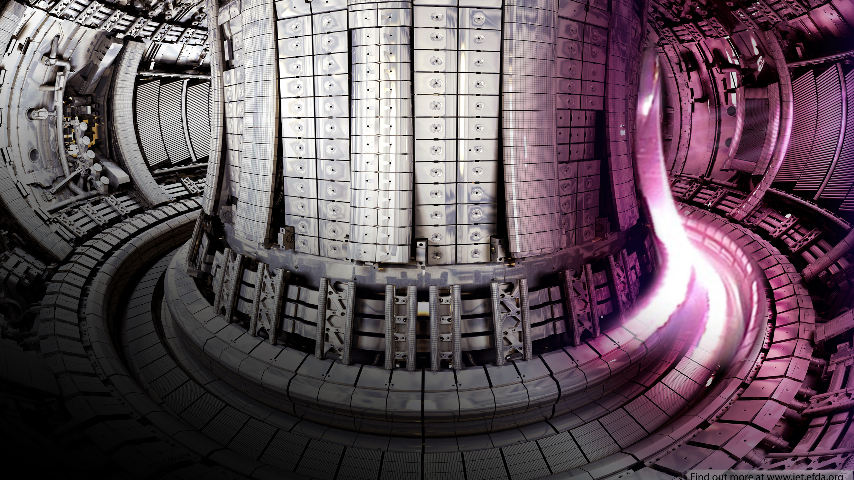
Optimising Tritium Production in Fusion Breeder Blankets
Vadan Khan and Rhodri Peters
Semester 1 Masters presentation

Slide 2
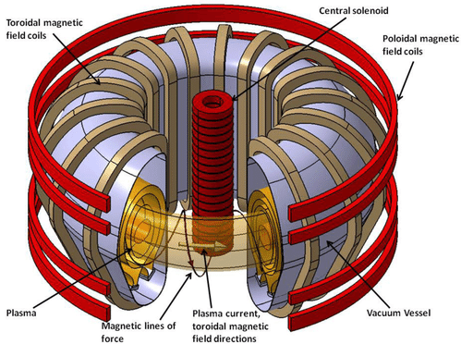
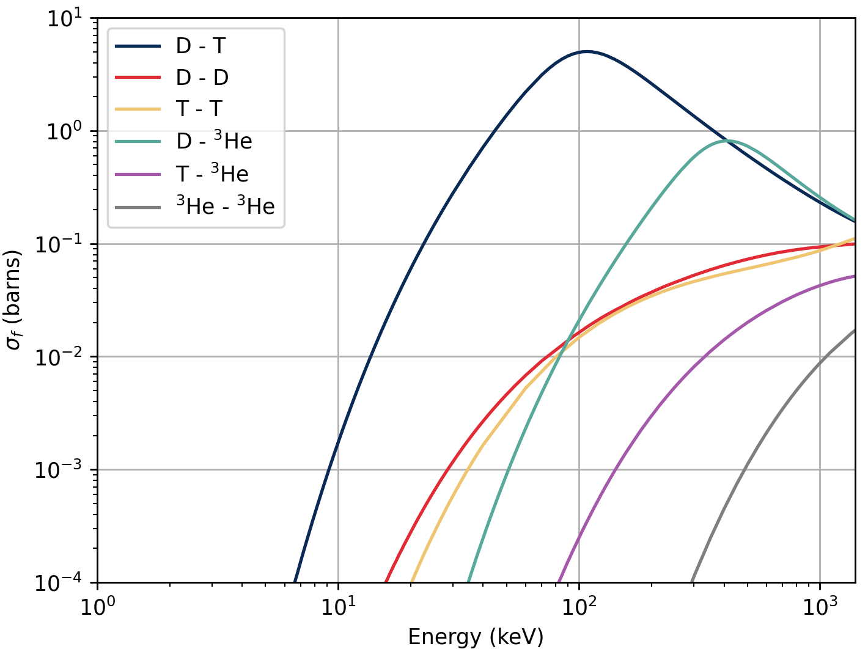
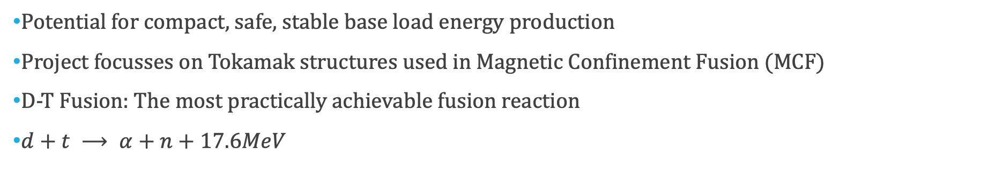
Introduction to Fusion
Potential for compact, safe, stable base load energy production
Project focusses on Tokamak structures used in Magnetic Confinement Fusion (MCF)
D-T Fusion: The most practically achievable fusion reaction
$d+t ⟶ α+n+17.6MeV$

Slide 3
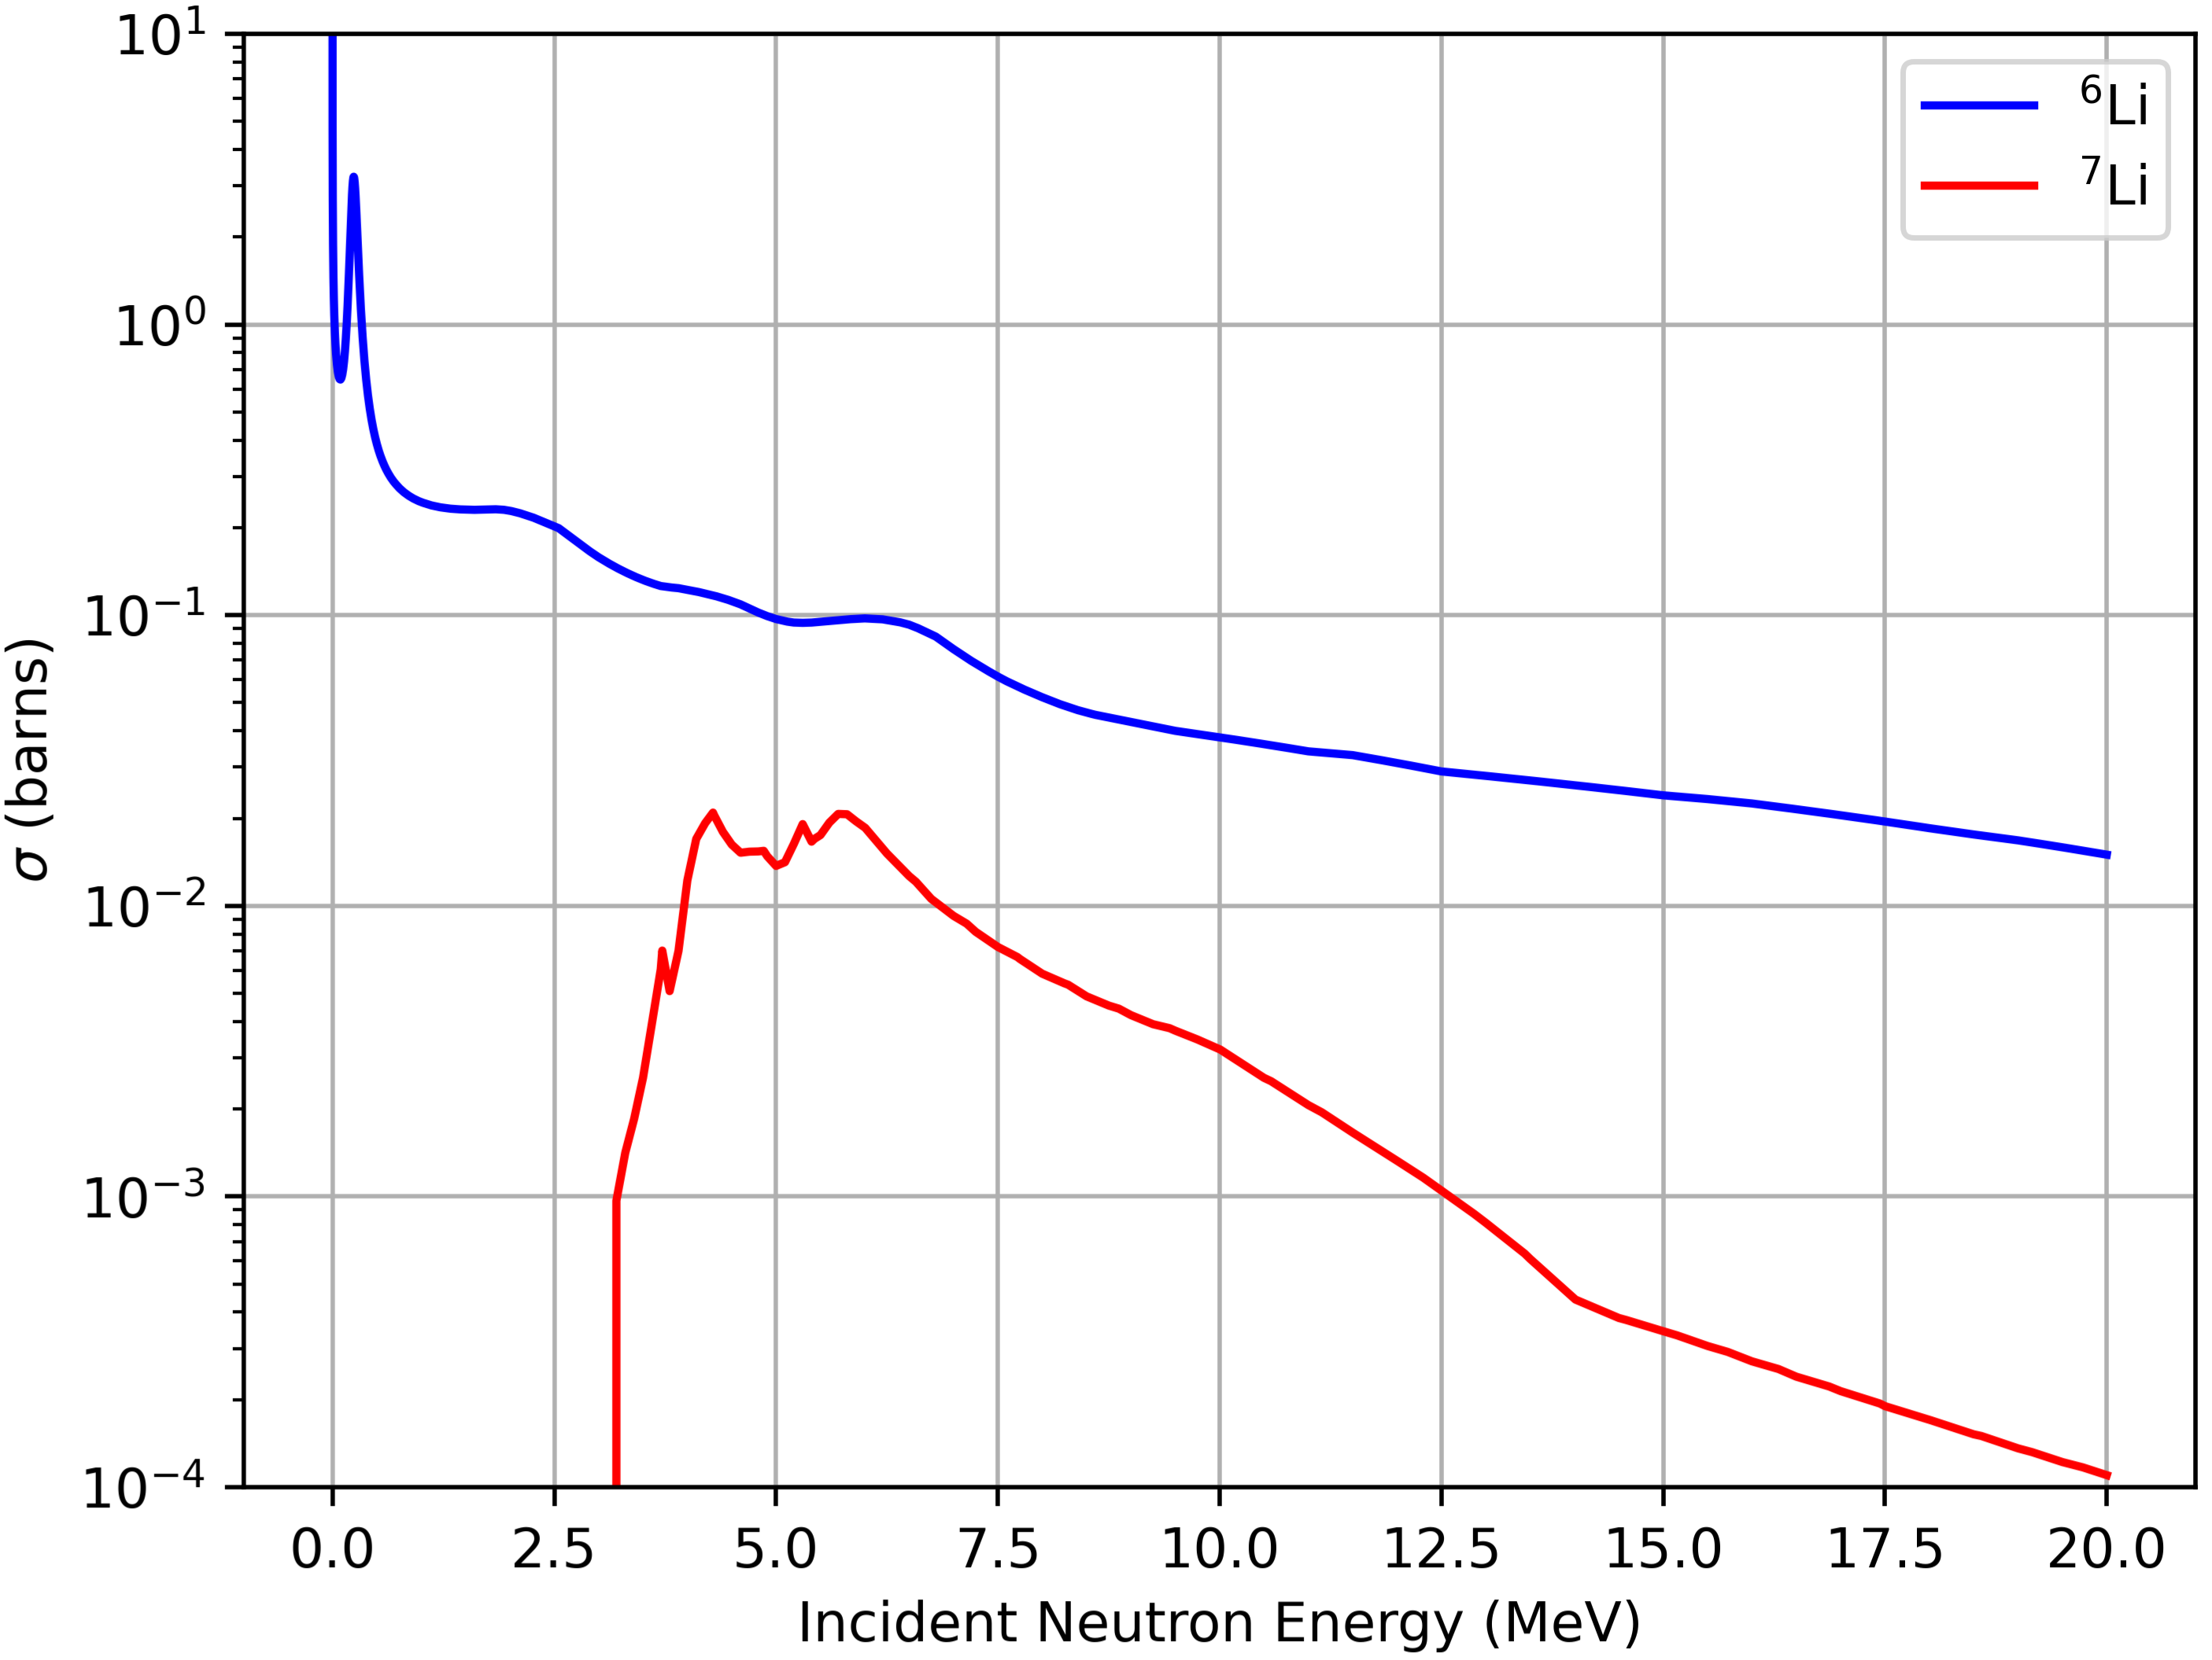
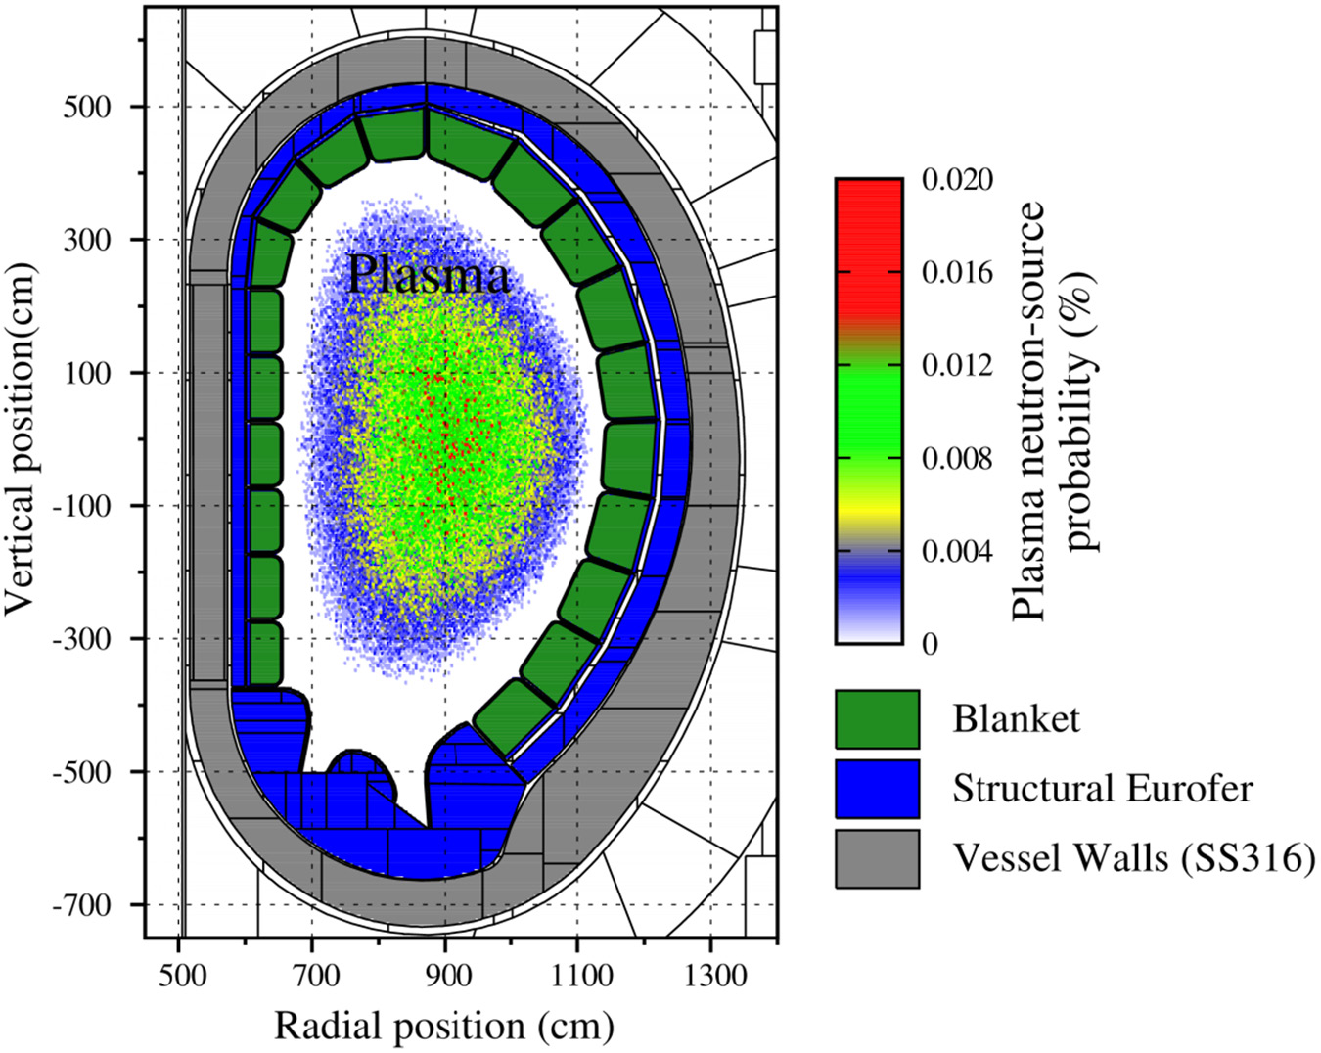
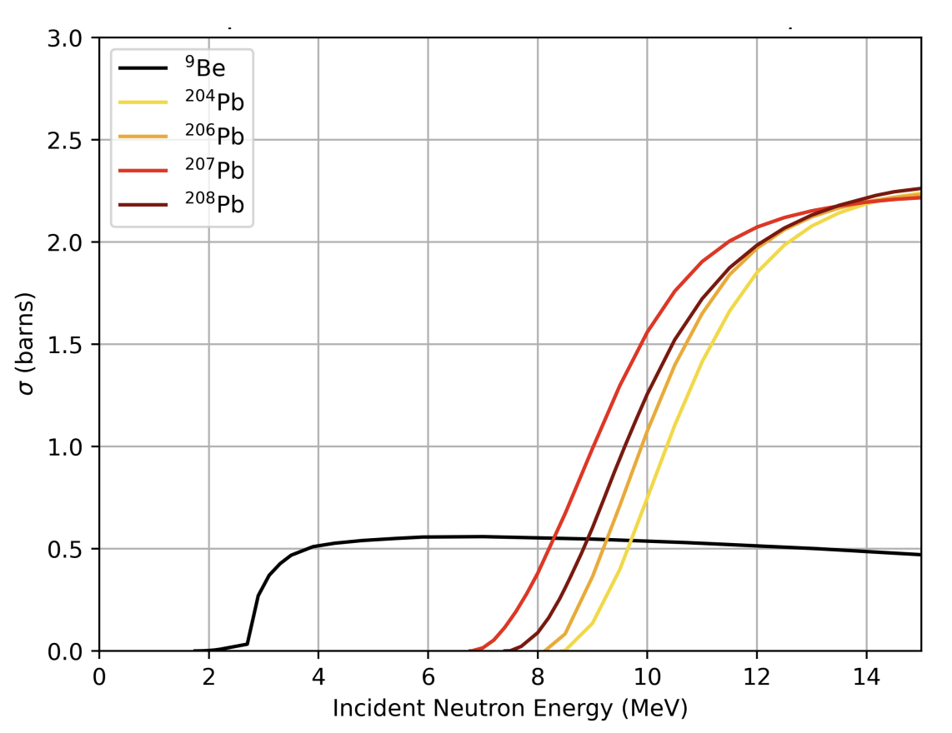
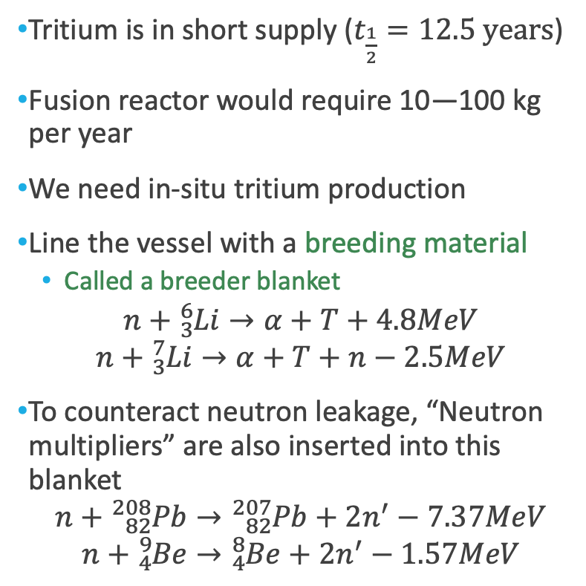
Breeder Blankets
Tritium is in short supply ($t_{\frac{1}{2}}=12.5 years$)
Fusion reactor would require 10—100 kg per year
We need in-situ tritium production
Line the vessel with a breeding material
Called a breeder blanket
$$n+{}_{3}^{6}{Li}→α+T+4.8MeV$$
$$n+{}_{3}^{7}{Li}→α+T+n−2.5MeV$$
To counteract neutron leakage, “Neutron multipliers” are also inserted into this blanket
$$n+{}_{82}^{208}{Pb}→{}_{82}^{207}{Pb+}2n^{′}−7.37MeV$$
$$n+{}_{4}^{9}{Be}→{}_{4}^{8}{Be}+2n^{′}−1.57MeV$$

Slide 4
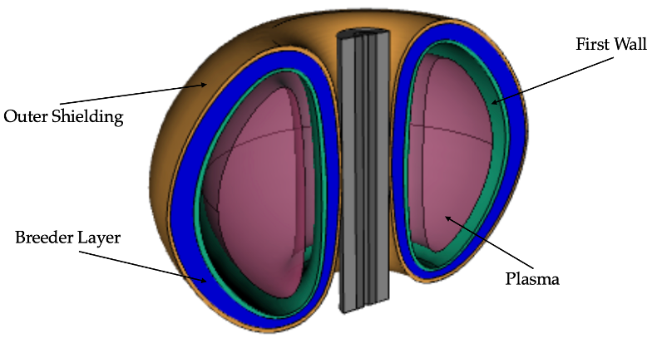
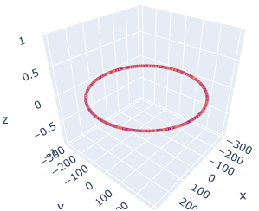

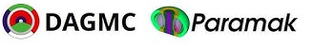
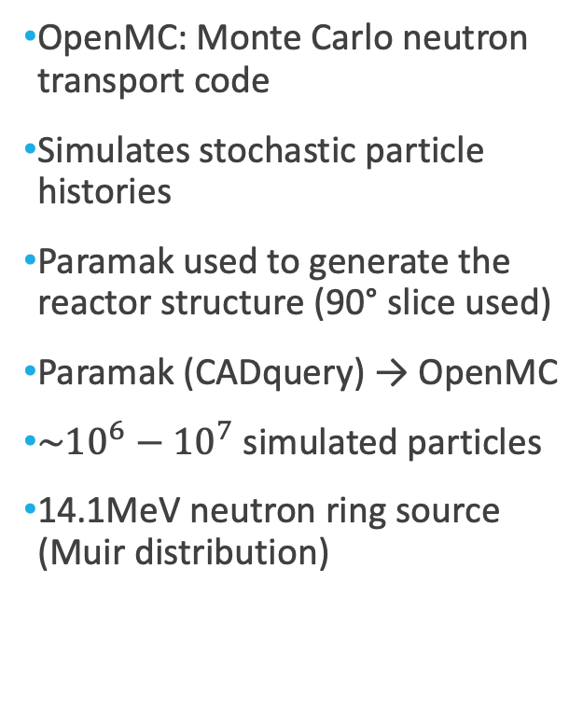
OpenMC and Simulation
OpenMC: Monte Carlo neutron transport code
Simulates stochastic particle histories
Paramak used to generate the reactor structure (90° slice used)
Paramak (CADquery) → OpenMC
$\sim {10}^{6}−10^{7}$ simulated particles
14.1MeV neutron ring source (Muir distribution)

Slide 5
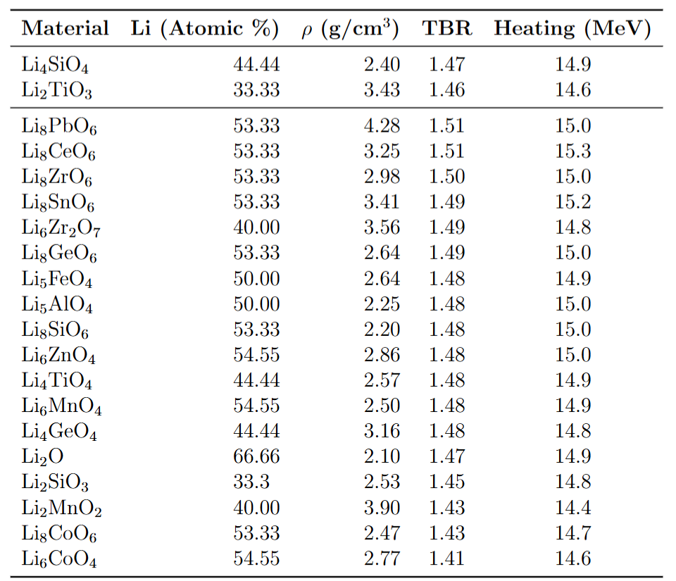
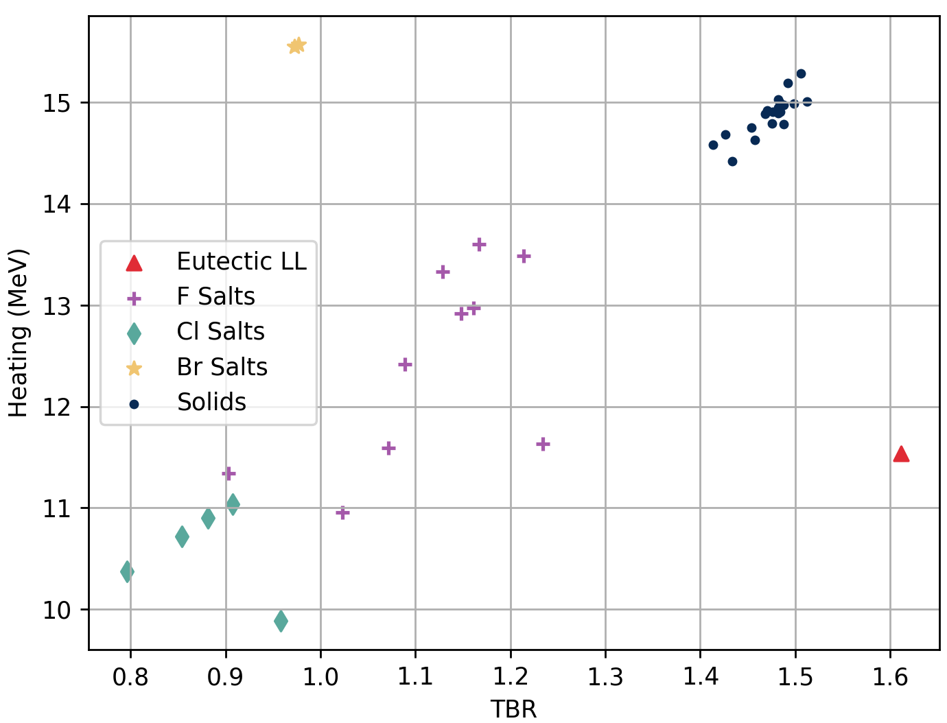
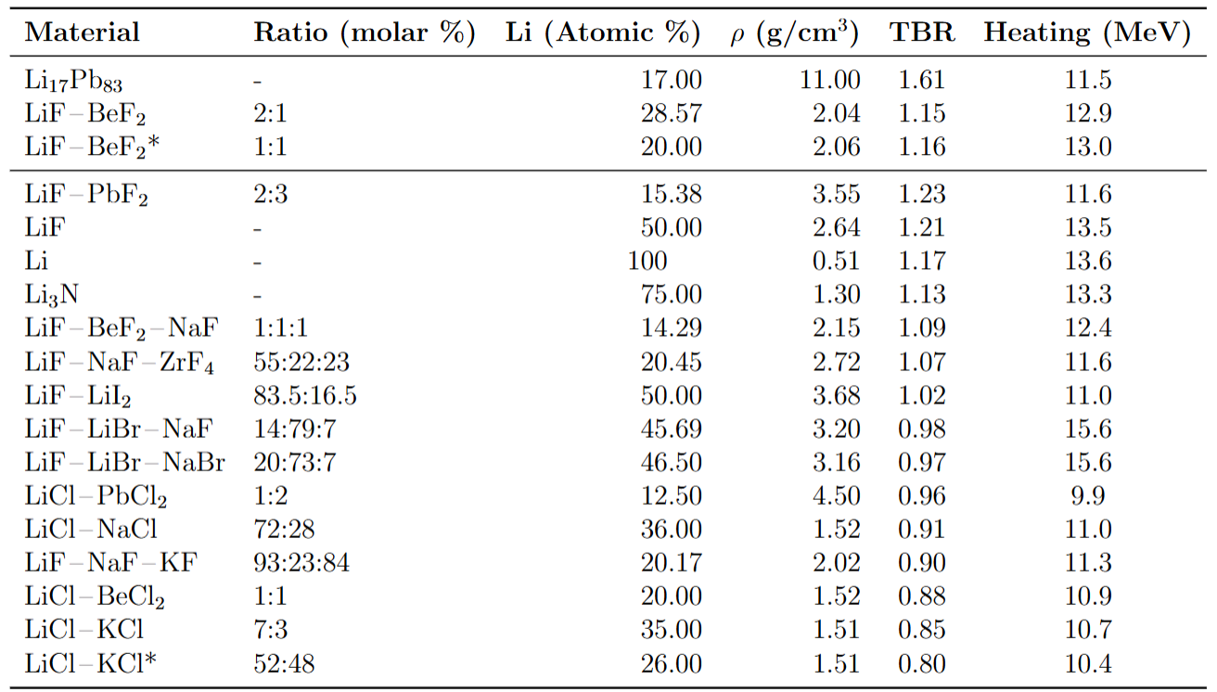
Liquid and Solid Breeder Materials

Slide 6
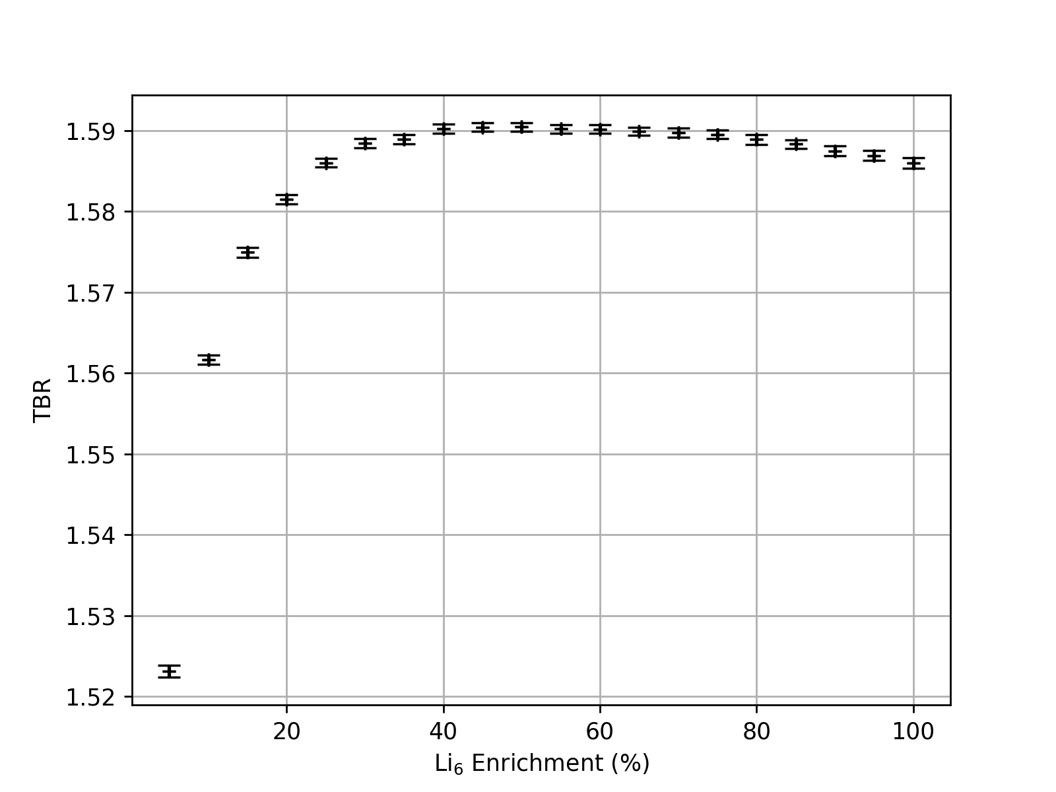
Lithium-6 Enrichment
Literature Values on Enrichment Vary from 40 - 90%
Our study suggests a saturation at 40%
Even 20 - 30 % could still be suitable as a compromise on expensive enrichment costs

Slide 7
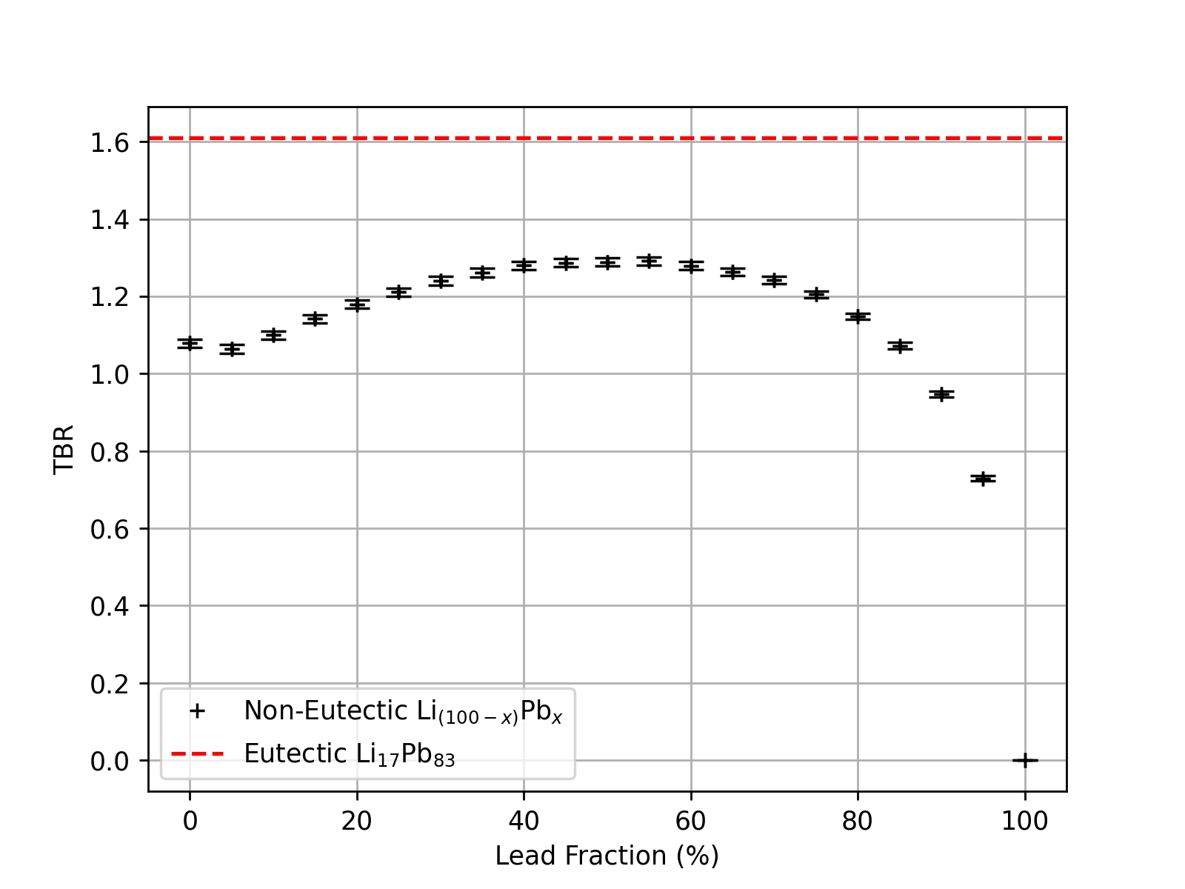
Lithium-Lead Multiplier Ratio
Foundational study assuming non-varying packing factors
Eutectic LiPb Alloy resulted in far higher TBR
Mostly due to its higher density
Demonstrates the significance of packing factors and alloy density

Slide 8
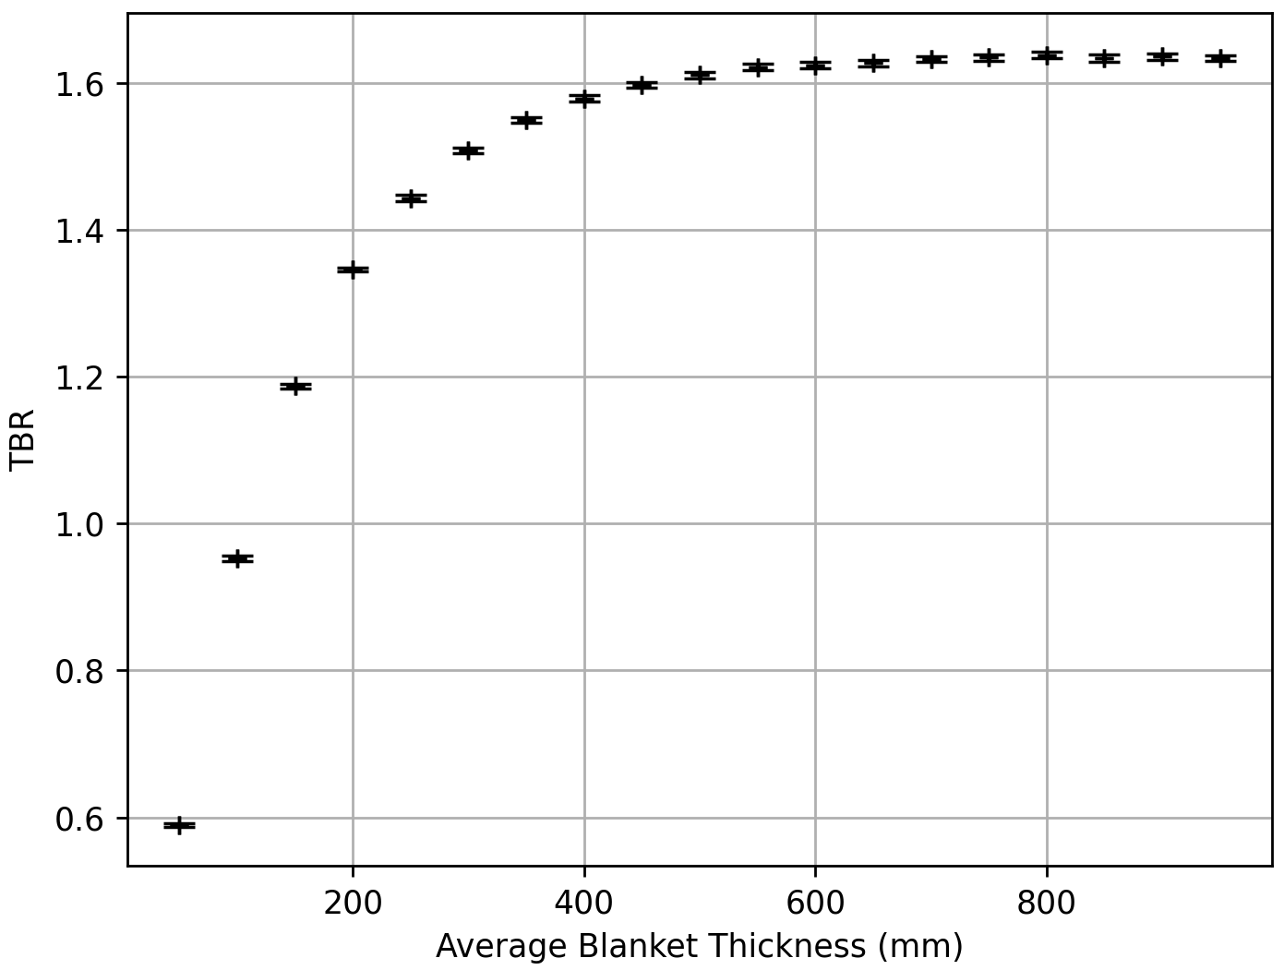
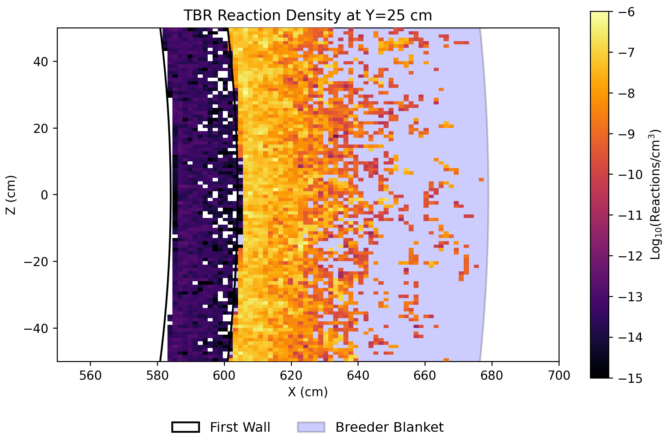
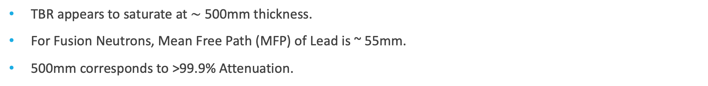
Breeder Blanket Thickness
TBR / Blanket Thickness
TBR Reaction Heatmap
TBR appears to saturate at $\sim$ 500mm thickness.
For Fusion Neutrons, Mean Free Path (MFP) of Lead is ~ 55mm.
500mm corresponds to >99.9% Attenuation.

Slide 9
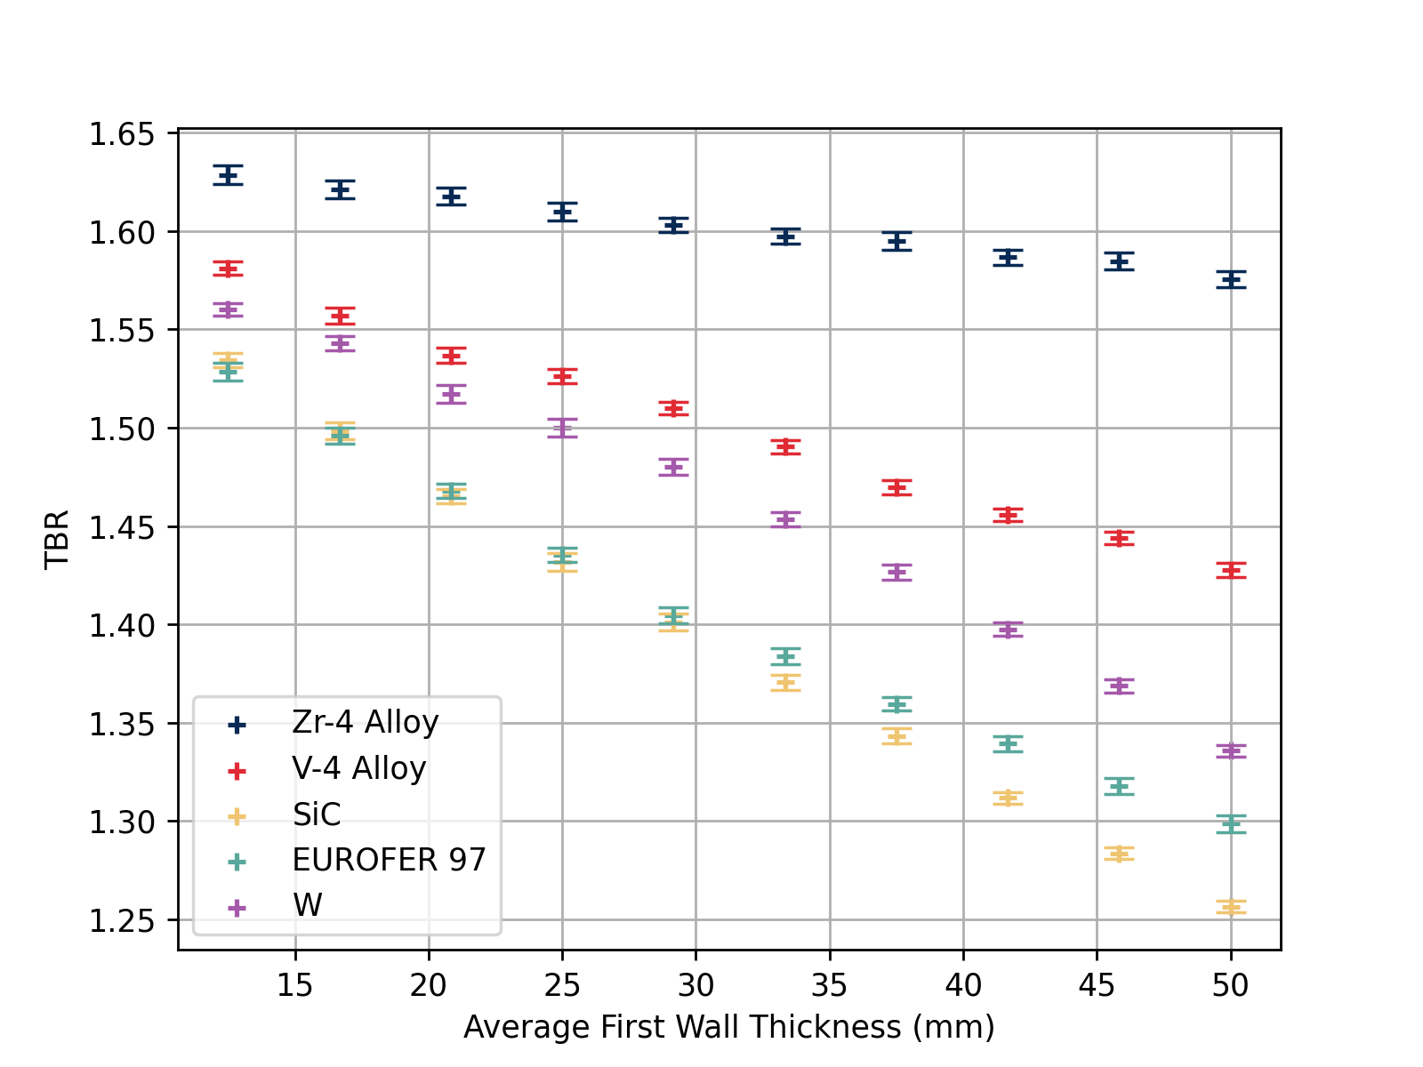
First Wall Thickness
Considering TBR alone, the zirconium alloy is far superior
Max thermal flux limit & plasma parameters could influence this choice in a real device

Slide 10
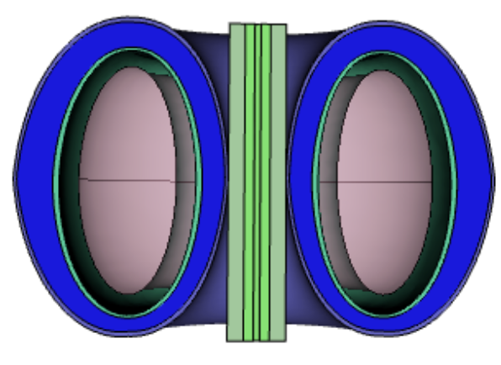
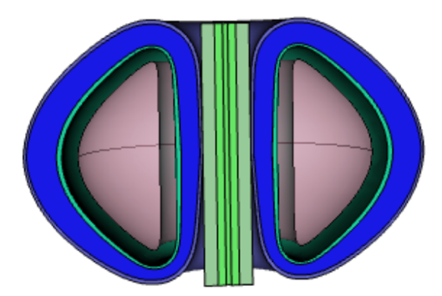
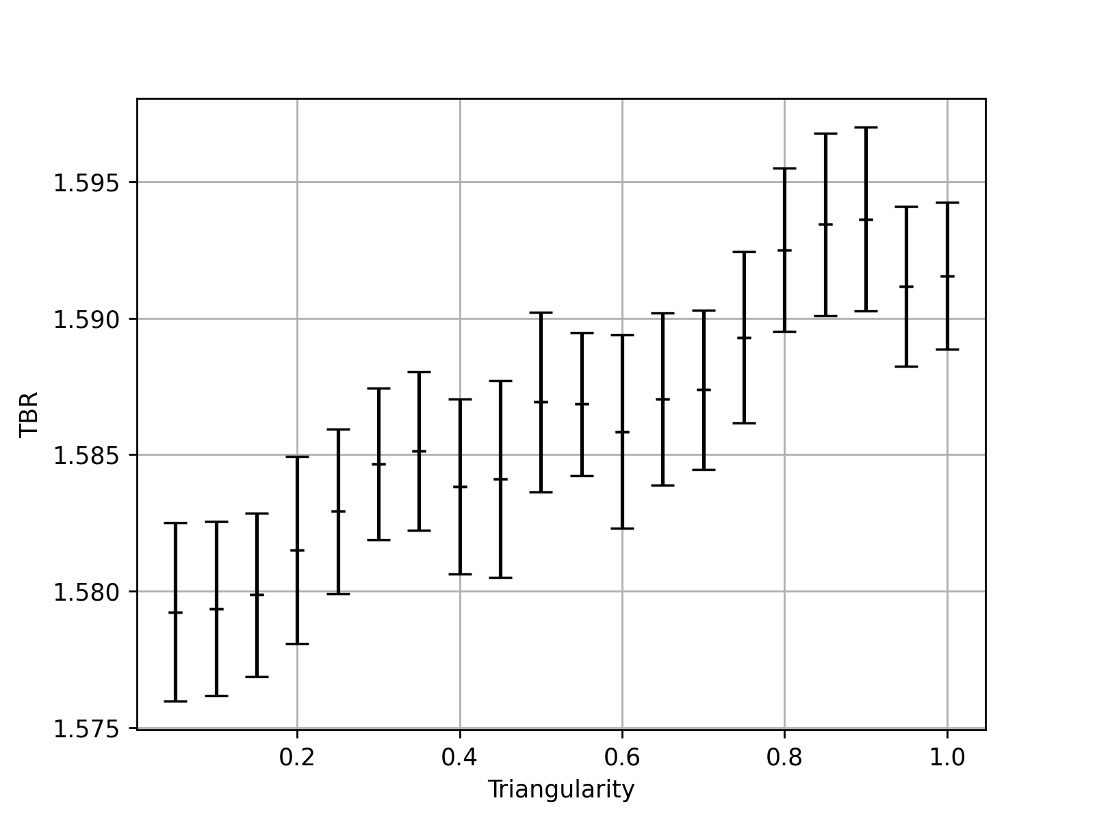
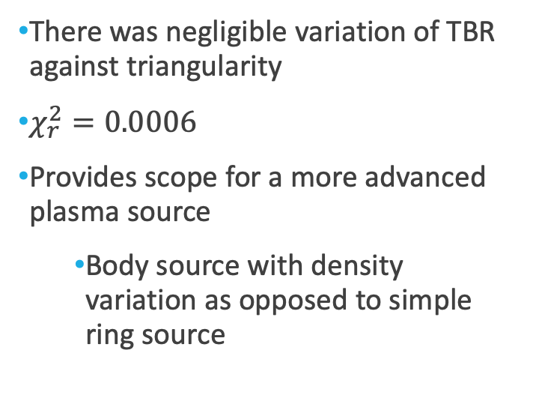
Triangularity
There was negligible variation of TBR against triangularity
$χ_{r}^{2}=0.0006$
Provides scope for a more advanced plasma source
Body source with density variation as opposed to simple ring source

Slide 11
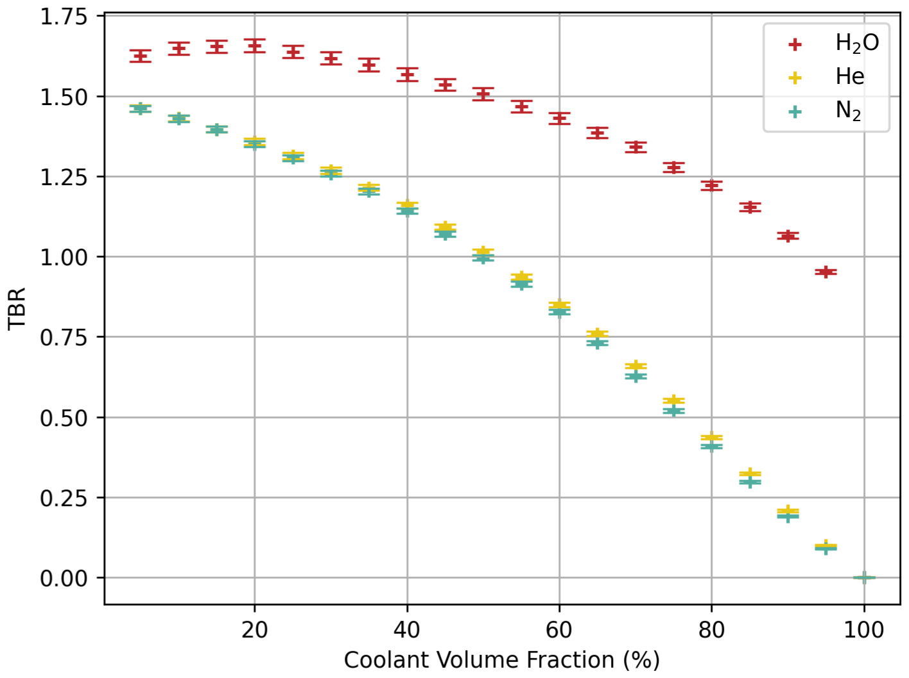
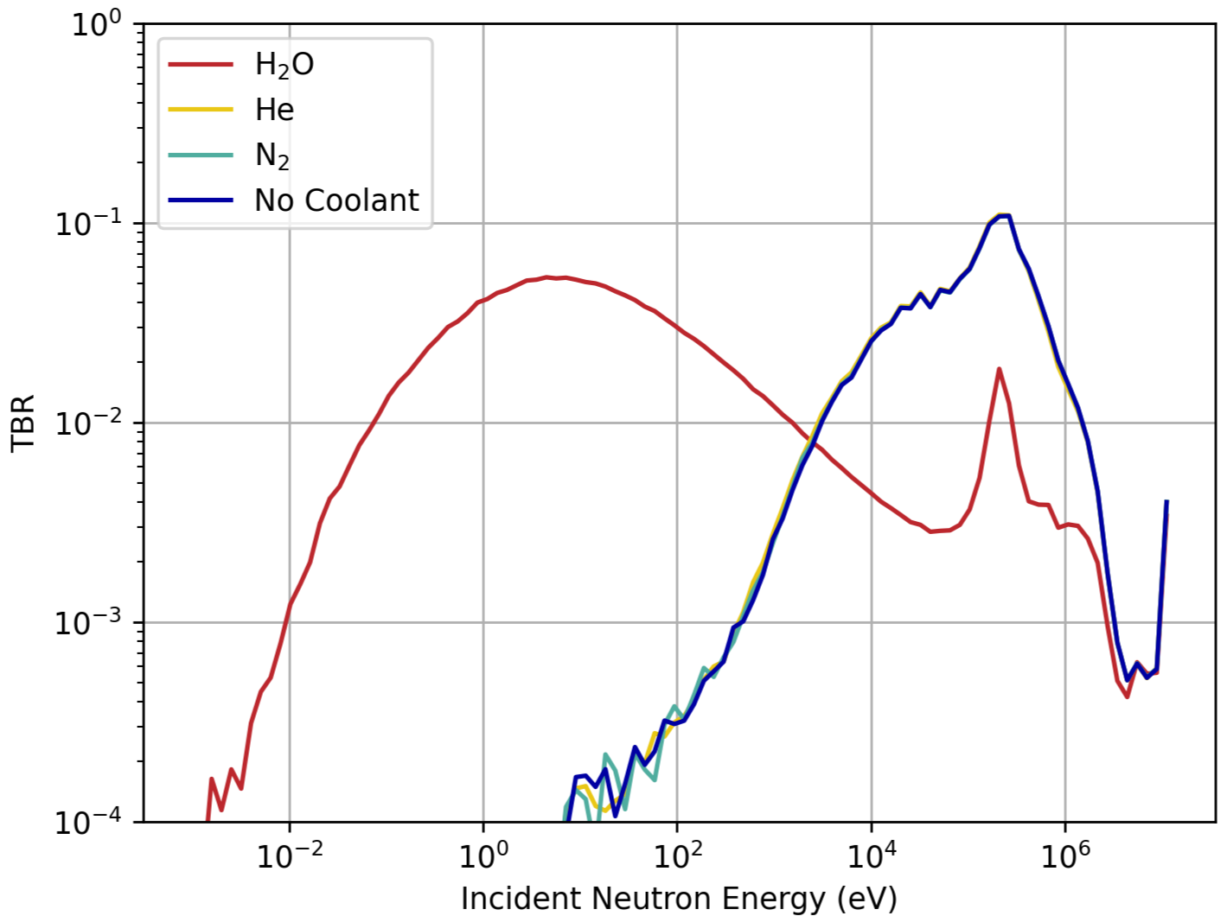
Coolant Materials
Tbr / coolant fraction
Tritium Breeding Neutron Energy
Water was found to be far superior for TBR as it can act as a moderator.
Lithium and water in close proximity poses a significant safety risk
Must account for the homogenous approximation

Slide 12
Limitations & Next Steps
Homogenous assumption → Heterogenous blanket upgrade
Plasma ring source → Plasma body source with density variation
Simplified Tokamak geometry → Complex structure more closely matched to real devices
Focus on TBR → Holistic consideration for heating & safety (minimise leakage fractions).

Slide 13
Backup Slides

Slide 14
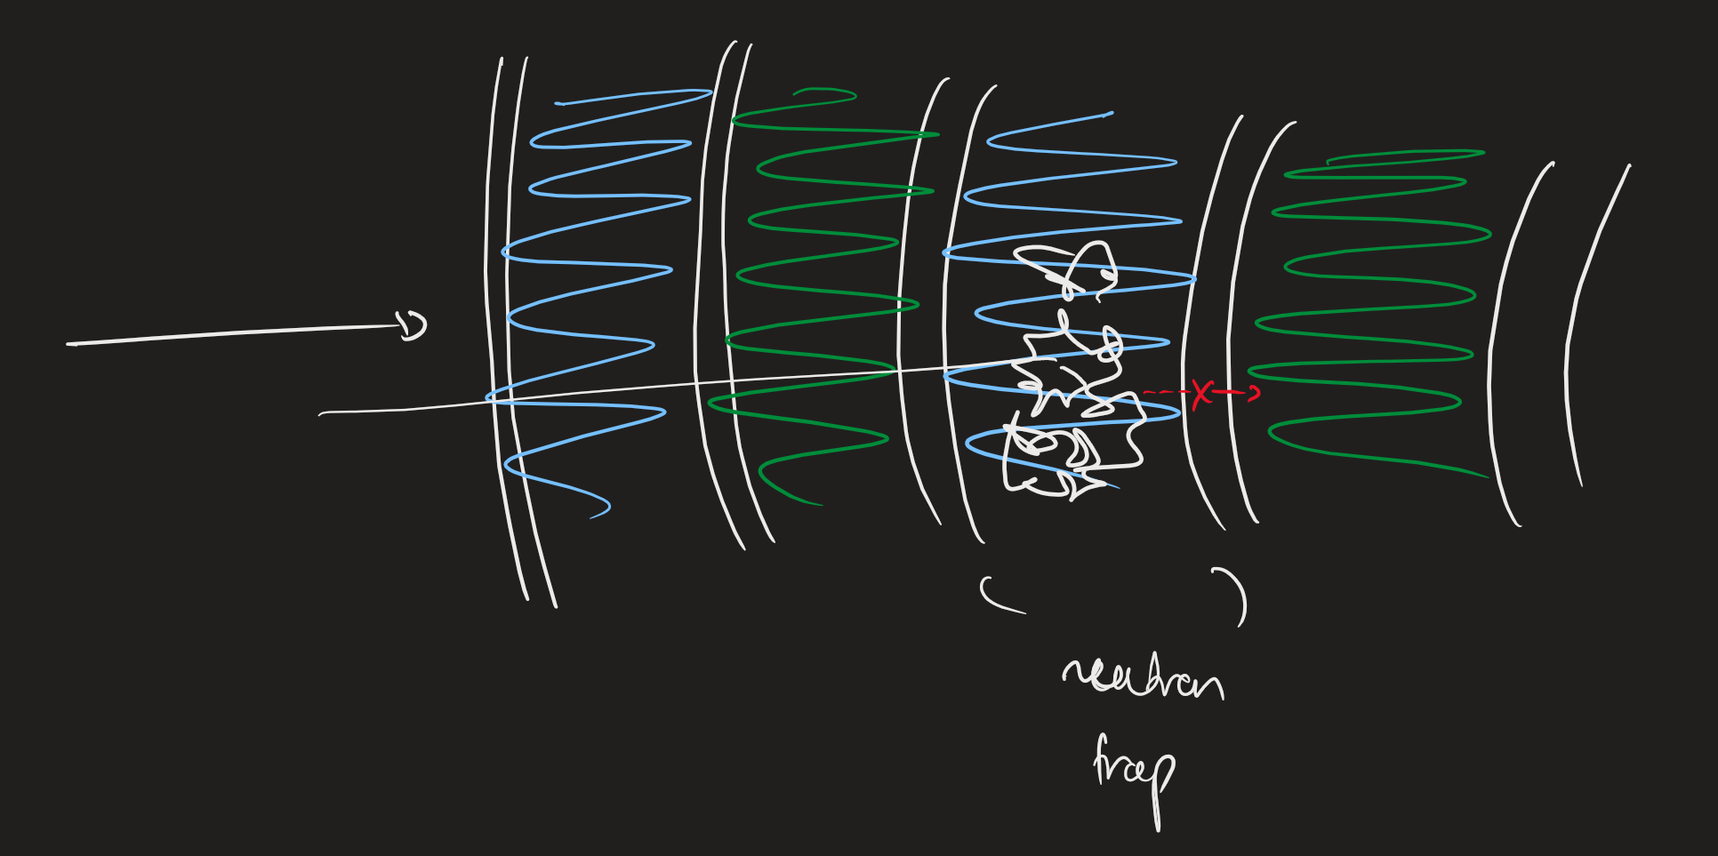
Heterogenous Structure Problems
Unlike Fission, we expect reaction rate / TBR to decrease with heterogeneity, as more barriers from moderation 🡪 breeding are encountered.

Slide 15
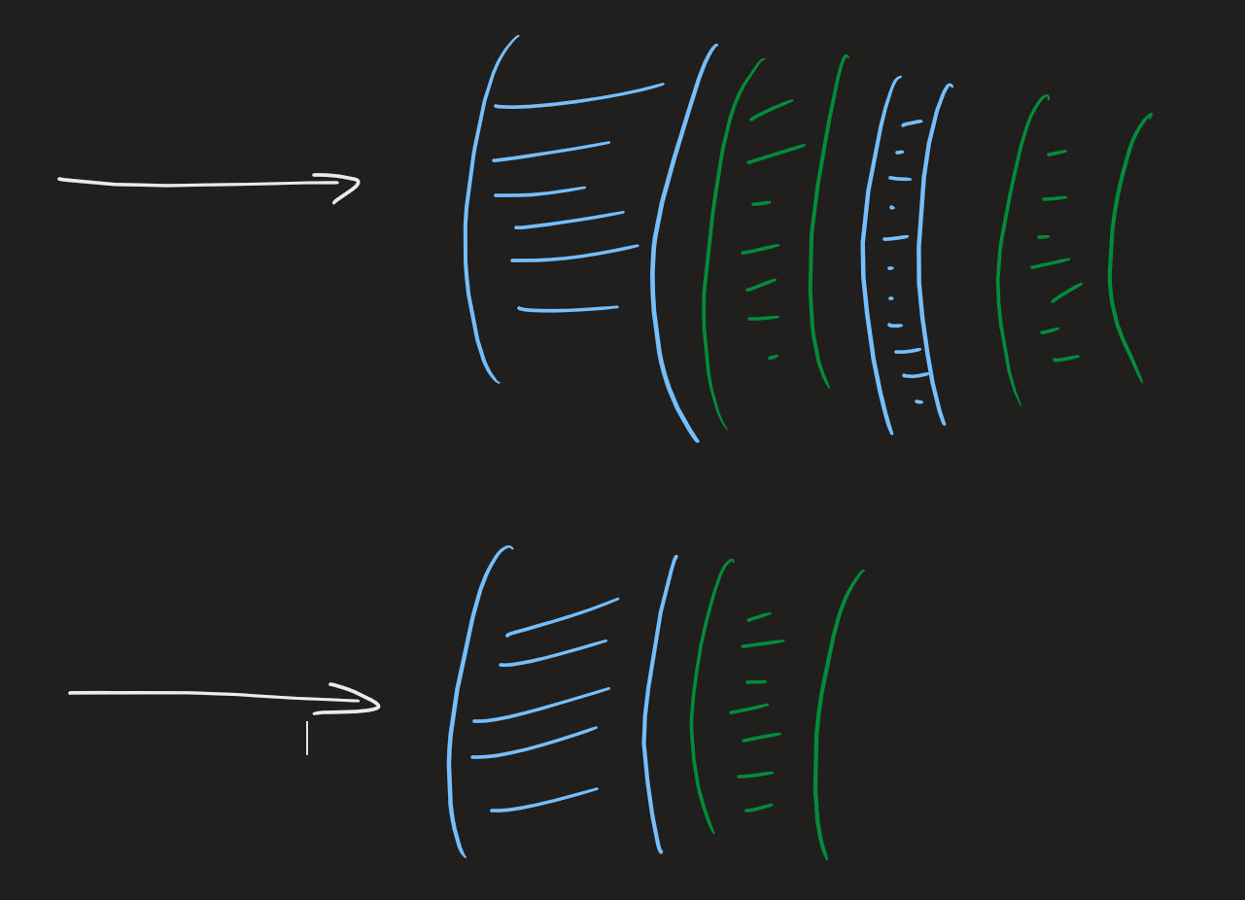
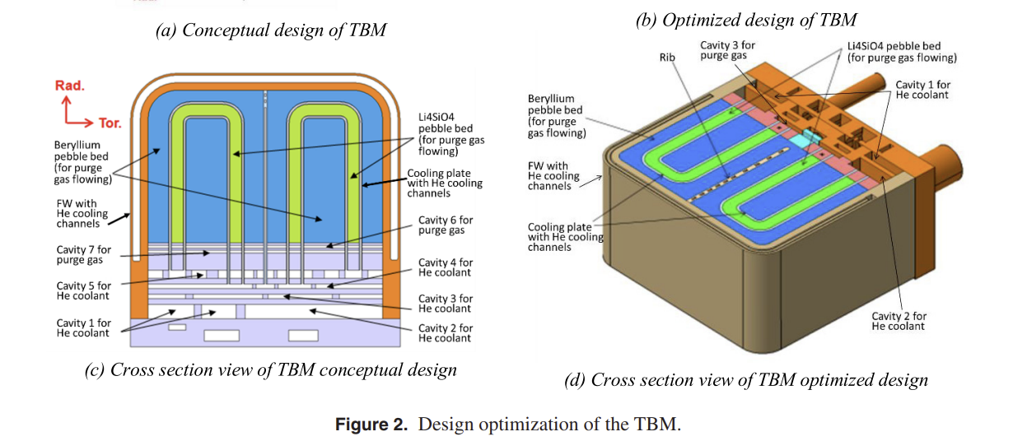
Heterogenous Structure Problems
Optimisation of the multi-layer thicknesses could be non-trivial
Want to have a water layer that is thick enough to moderate but not too thick to fully attenuate
Might want multiple layers for more “realistic” mimicking / avoiding neutron traps.
Real modules (CN HCCB) have piping structures so perhaps different approach required

Slide 16
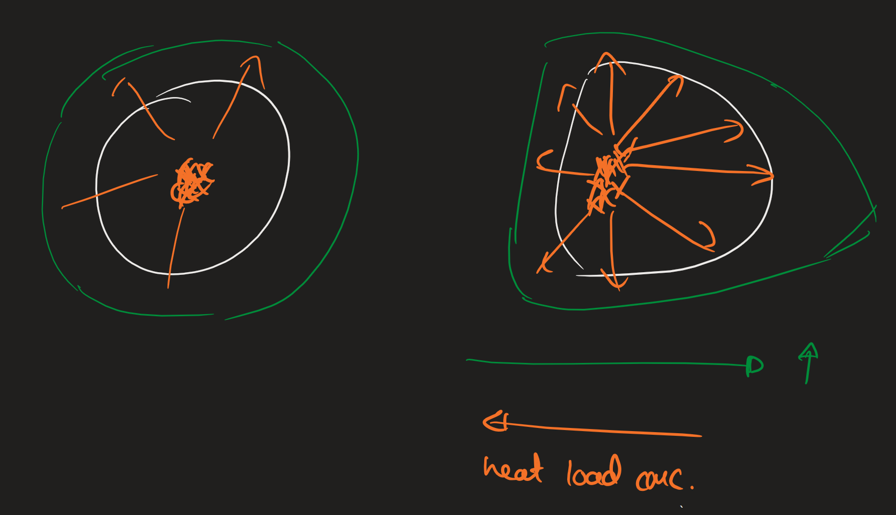
Plasma Body Source
We expect it to introduce asymmetric heat load on different parts of the tokamak
This may increase the TBR if the thickness at all points is at least 500mm (as certain solid angles experience greater geometric thickness)
But it could require varying thickness if below saturation thickness (as the inner walls experience too great a neutron flux)
Also any increases in TBR could be cancelled by the increase in heating management concerns

